Slide 1
Federal Reserve's dual mandate
Shariq Mian

Slide 2
Federal Reserve's dual mandate
Controlling Inflation, target ~ 2%
Maintaining low unemployment. No specific target.
Fed does this by changing the Federal Funds Rate

Slide 3
Data
Used FRED API (3 Series)
FEDFUNDS
UNRATE
CORESTICKM159SFRBATL
Sep 1998- Aug 2023
Monthly Data

Slide 4
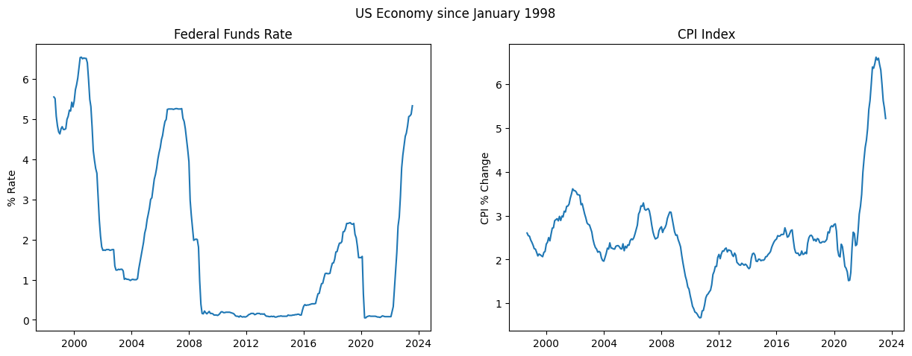
BUSINESS OPPORTUNITIES ARE LIKE BUSES. THERE'S ALWAYS ANOTHER ONE COMING.​
1st View: Federal Fund Rate Vs CPI Index
Inflation has been creeping around 1-3.5 percent range until 2022, we see a major spike to ~ 6.5%

Slide 5
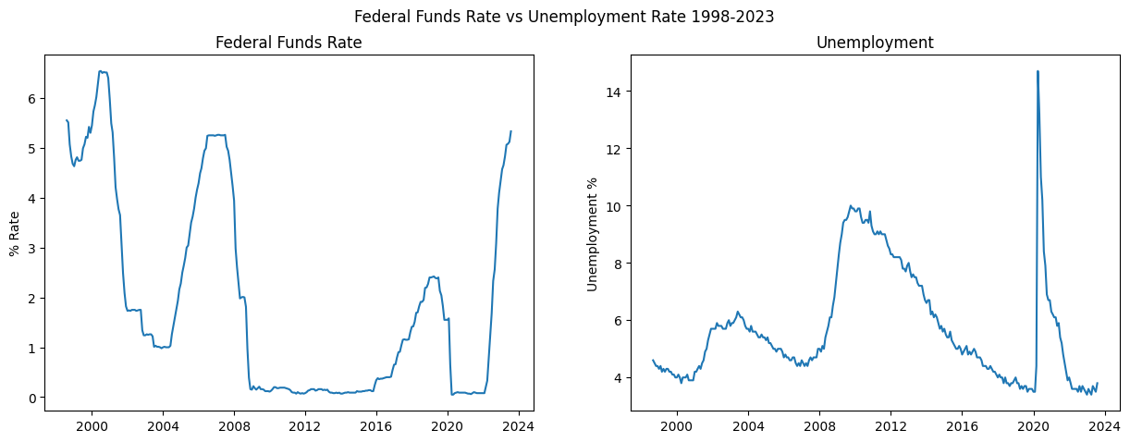
BUSINESS OPPORTUNITIES ARE LIKE BUSES. THERE'S ALWAYS ANOTHER ONE COMING.​
2nd View: Federal Fund Rate Vs Unemployment Rate
We see 3 peaks, We can refer to these as Cycles.
Significant events happened prior to these peaks. 2003-2004 (dot com bubble), 2008 (Financial Crisis), 2020 (COVID 19)

Slide 6
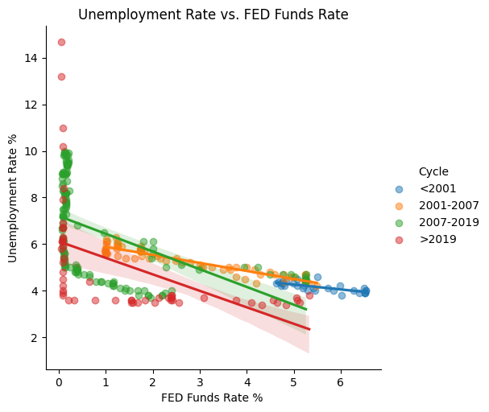
We divided the history n 4 cycles, a cycle is when the fed goes though the proves of increasing and then decreasing interest rates.
Overall, there is a negative relationship between Unemployment Rate and Fed Funds Rate. This is because The Fed reduces the interest rates when Unemployment is High allowing company to have access to cheaper capital.

Slide 7
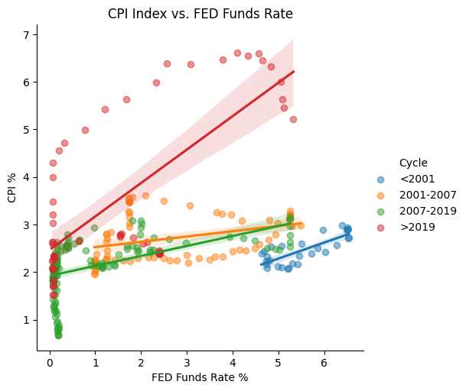
There is a positive relationship between CPI and FED Funds Rate, this is because in order to control inflation, the FED increase rates

Slide 8
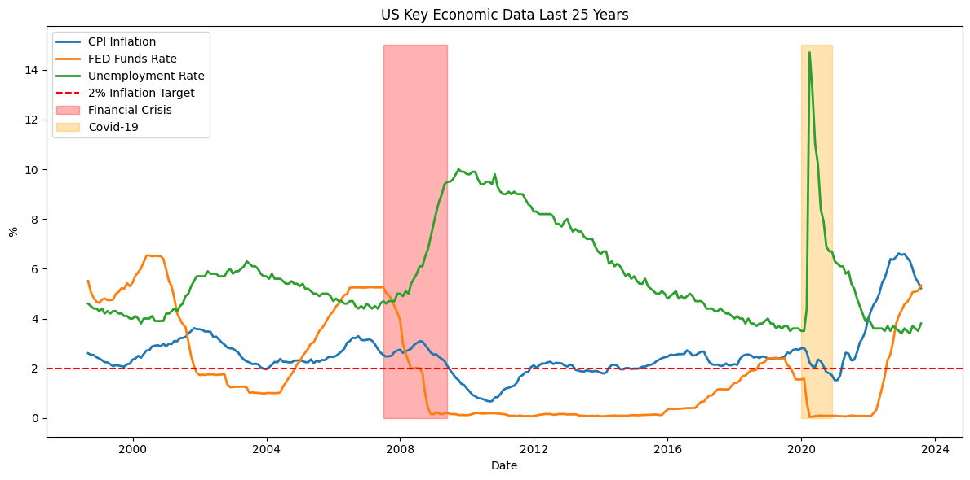
Putting all 3 on graph, overall we can see inflation is close to around 2% range while unemployment varies.
Significant events happened prior to these peaks. 2008 (Financial Crisis), 2020 (COVID 19) During these time we see rates plunging to Zero. This is because fed wants to simulate economy through easy money.

Slide 9
CONCLUSION
Unemployment Rate
Easy Money
Final Comments
Unemployment Rates has a higher variation than Inflation, this is because the FED fears Inflation more than high unemployment
From 2009 to 2018, US had a time of easy money with low interest rates. Suddenly when COVID 19 hit, they were not able to reduce interest rates slowly, with sudden plunge f interest rates to 0 and lots of stimulus packages, resulted in high inflation which went out of control.
Overall, the fed does a great job, keeping Inflation ~ 2 percent but it get tough when we see black swan events.

